Slide 1
Chapter 4
Threads

Slide 2
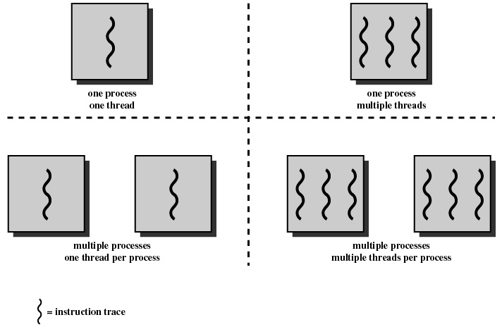
Multithreading
Operating system supports multiple threads of execution within a single process
MS-DOS
JRE
UNIX
Windows, Solaris
Linux, new UNIX
Single-threaded
Multithreaded

Slide 3
Multithreading
A process is defined as the unit of resource allocation and a unit of protection.
A virtual address space that holds the process image.
Protected access to:
processors
other processes
files
I/O resources

Slide 4
Multithreading
Each thread in a process has
an execution state (running, ready, etc.)
saved thread context when not running
an execution stack
some per-thread static storage for local variables
access to the memory and resources of its process
all threads of a process share this

Slide 5
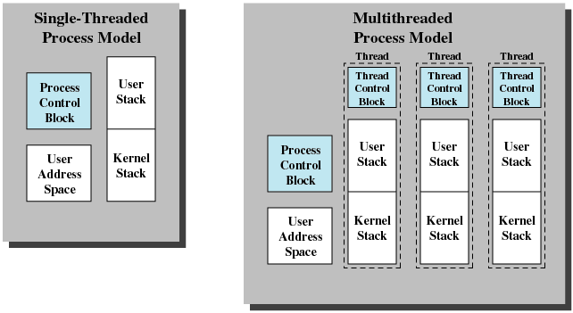
Multithreading
Thread control block containing register values, priority and other state information.

Slide 6
Multithreading
In an OS that supports threads, scheduling and dispatching is done on a thread basis.
Most of the state information dealing with execution is maintained in thread-level data structures
suspending a process involves suspending all threads of the process
termination of a process terminates all threads within the process

Slide 7
Benefits of Threads
Takes less time to create a new thread than a new process
Take less time to terminate a thread
Take less time to switch between two threads within the same process
Since threads within the same process share memory and files, they can communicate with each other without invoking the kernel

Slide 8
Drawbacks of Threads
Requires careful design (shared variables)
Hard to debug because the interaction between threads very hard to control.

Slide 9
Multithreading
Uses of threads in multiprocessing system
Foreground and background work, example: one thread could display menus and read user input, another thread executes user commands
Asynchronous processing: a thread to backup data periodically
Speed of execution: on a multiprocessor system, multiple threads can execute simultaneously
Modular program structure: programs with many activities or input and output can implement using threads

Slide 10
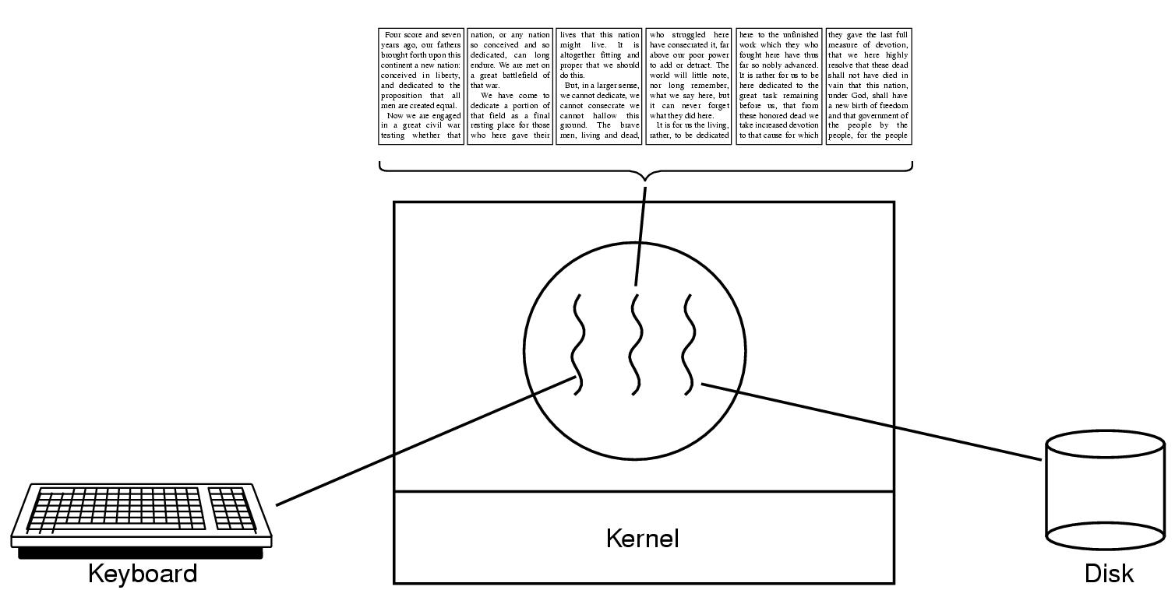
Multithreading
Example: Word Processor
Spell & grammar checking
✓
ABC

Slide 11
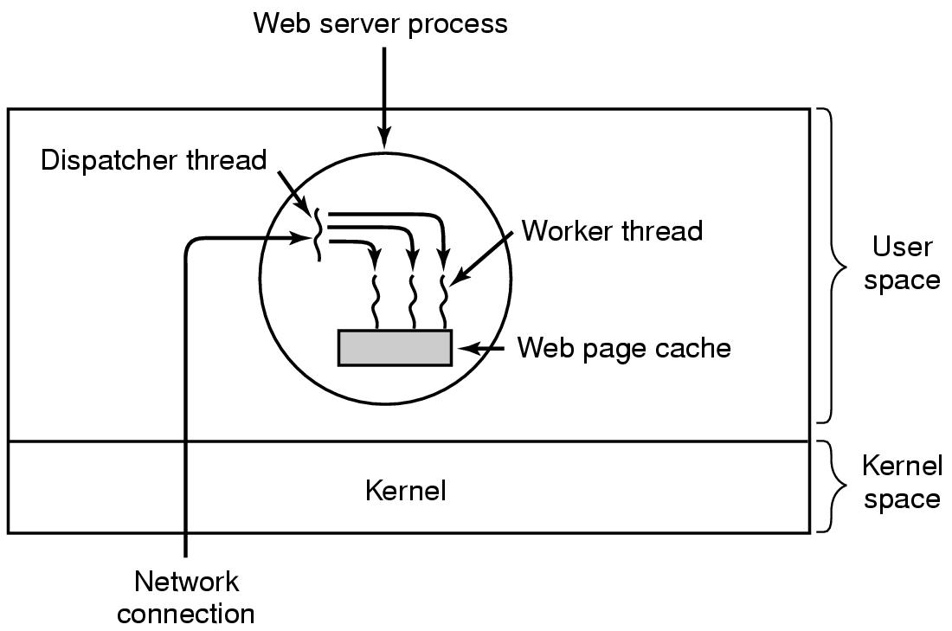
Multithreading
Dispatcher accepts new request and passes it to an idle worker. Worker tries to get the page from cache, if not in cache, read from disk (blocked)

Slide 12
Multithreading
Suspending a process involves suspending all threads of the process since all threads share the same address space
Termination of a process, terminates all threads within the process

Slide 13
Thread States
States associated with a change in thread state
Spawn
Spawn another thread
Block
Unblock
Finish
Deallocate register context and stacks

Slide 14
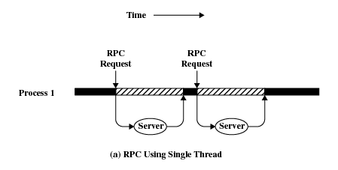
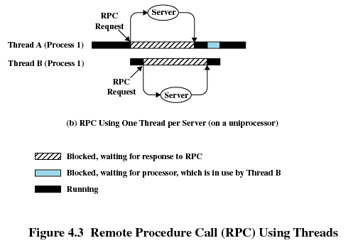
Remote Procedure Call (Single Thread)

Slide 15

Remote Procedure Call (Multithread)

Slide 16
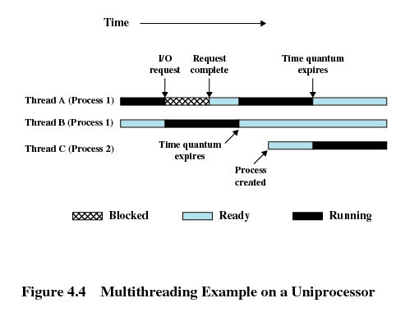
Multiprogramming on Uniprocessor

Slide 17
Multithreading - Synchronisation
It is necessary to synchronize the activities of the various threads
all threads of a process share the same address space and other resources
any alteration of a resource by one thread affects the other threads in the same process

Slide 18
Multithreading
2 categories of thread implementation:
User-level threads (ULT)
Kernel-level threads (KLT)

Slide 19
User-Level Threads
All thread management is done by the application
The kernel is not aware of the existence of threads (schedule on process basis & assign single process state)
Applications can be programmed to be multithreaded using threads library that contains code for
creating and destroying threads
passing messages and data between threads
scheduling thread execution
saving and restoring thread contexts

Slide 20
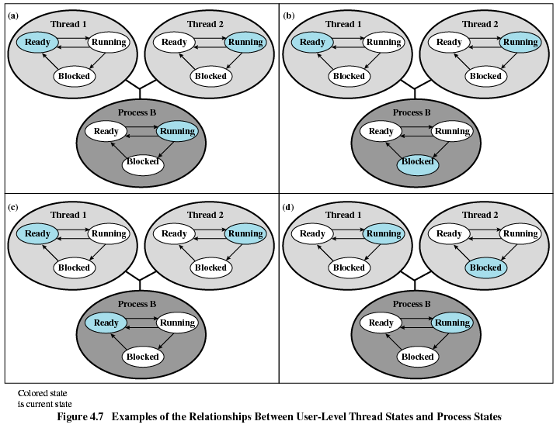
ULT States vs. Process States
Suppose thread 2 in process B is executing

Slide 21
ULT States vs. Process States
Possible occurrence 1:
Application in thread 2 makes a I/O call that blocks process B, the kernel switches to another process. Thread 2 is perceived in Running state by the thread library.

Slide 22
ULT States vs. Process States
Possible occurrence 2:
Process B exhausted its time slice and is placed in Ready state, but the data structure managed by thread library shows that thread 2 is still running.

Slide 23
ULT States vs. Process States
Possible occurrence 3:
Thread 2 needs some actions performed by thread 1. Thread 2 is blocked and thread 1 is executing.

Slide 24
Advantages of ULTs
Thread switching does not require kernel mode privileges → save the overhead of mode switches
Scheduling algorithm can be tailored to application without disturbing OS scheduler.
Can run on any OS. Threads library is a set of application-level utilities.

Slide 25
Disadvantages of ULTs
When a ULT makes a system call, all of the threads in the process are blocked.
Multithreaded application cannot take advantage of multiprocessing in a pure ULT strategy → one process is assigned to one processor → only one thread can execute at a time.

Slide 26
Kernel Level Threads (KLTs)
Thread management done by the kernel.
Windows is an example of this approach
No thread management code in application area, only application programming interface (API) to the kernel thread facility.
Kernel maintains context information for the process and the threads
Scheduling is done on a thread basis

Slide 27
Kernel Level Threads (KLTs)
Advantages
The kernel can simultaneously schedule multiple threads from a process on multiple processors.
If the thread is blocked, the kernel can schedule another thread from the same process.
The kernel themselves can be multithreaded.
Disadvantage
The transfer of control to another thread in the same process requires a mode switch to the kernel.

Slide 28
Combined Approaches of ULTs and KLTs
Example is Solaris
Thread creation done in the user space
Scheduling and synchronization of threads within application.
ULTs from an application are mapped onto KLTs.
Multiple threads can run concurrently on multiple processors
A blocking system call need not block the entire process.

Slide 29
Example: Valve Game Software
Source engine uses multithreading to exploit the power of multicore processor
Threading granularity options:
Coarse threading
Fine-grained threading
Hybrid threading

Slide 30
Example: Valve Game Software
Coarse threading:
Individual systems (modules), are assigned to individual processors.
Rendering on one processor, AI (artificial intelligence) on another, physics on another, and so on.
Fine-grained threading
similar or identical tasks are spread across multiple processors. Example, a loop that iterates over an array of data can be split up into a few parallel loops

Slide 31
Example: Valve Game Software
Hybrid threading:
Use fine-grained threading for some systems and single threading for other systems
Hybrid threading approach was the most promising and would scale the best, as multicore systems with 8 or 16 processors became available.
Certain systems can be permanently assigned to a single processor, example, sound mixing (little user interaction, works on its own set of data)

Slide 32
Example: Valve Game Software
Render
Skybox
Main
V
iew
Monitor
Etc.
Scene List
For
each object
Particles
Sim and Draw
Character
Bone Setup
Draw
Etc.

Slide 33
Example: Valve Game Software
Higher-level threads spawn lower-level threads as needed. Example:
determine what are the areas of the world to be rendered
determine what objects are in the scene as viewed from multiple angles
rendering module has to render each object from multiple points of view, such as the player’s view, the view of TV monitors, and the point of view of reflections in water.

Slide 34
Example: Valve Game Software
Key elements of the threading strategy for the rendering module
Construct scene-rendering lists for multiple scenes in parallel (e.g., the world and its reflection in water)
Overlap graphics simulation
Compute character bone transformations for all characters in all scenes in parallel
Allow multiple threads to draw in parallel

